Slide 1
Distilling the Knowledge in a Neural Network
arXiv preprint, 2015

Slide 2
Contents
Expensive Ensemble
Distilling Ensemble: Single Model
Result & Conclusion
Training Ensemble Fast (Next time...)

Slide 3
Overfitting of ANN
ANN is easily overfitted to training data
Due to many parameters
Output
Input

Slide 4
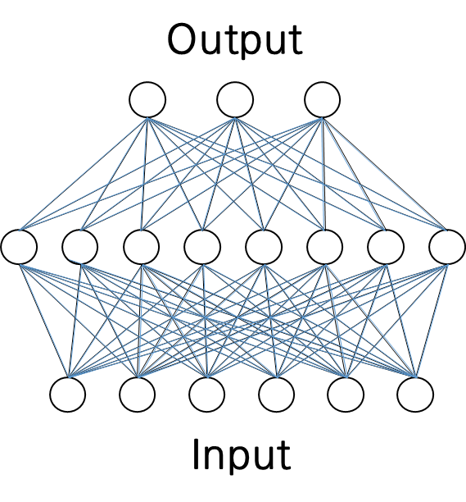
ANN Ensemble
To improve generalization performance
Ensemble could be used
Output
Input

Slide 5
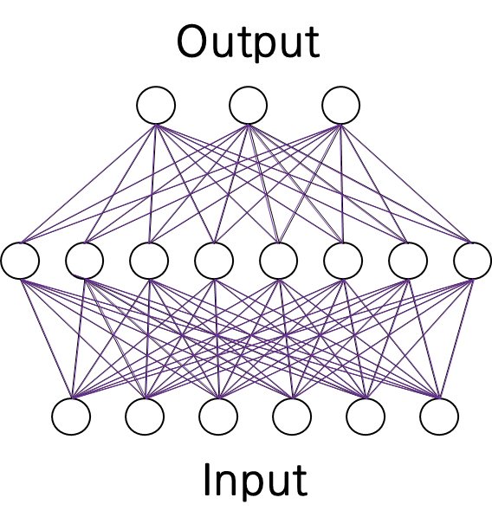
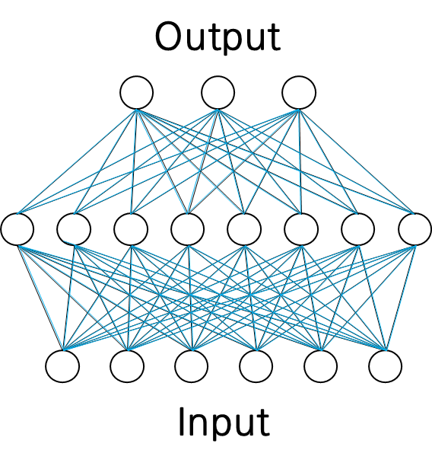
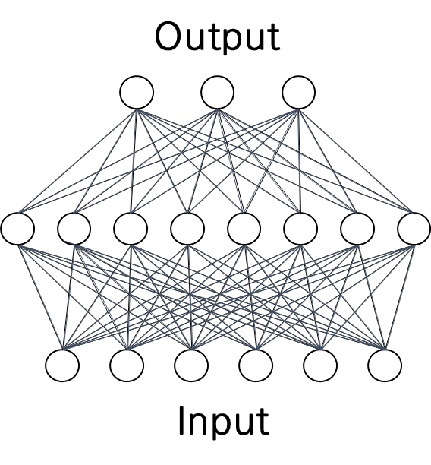
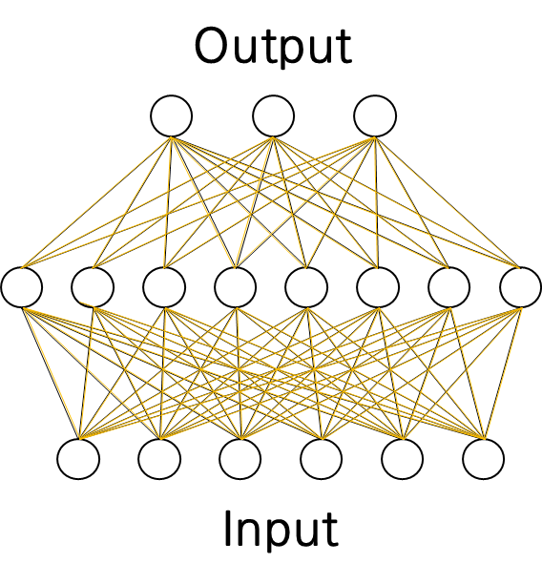
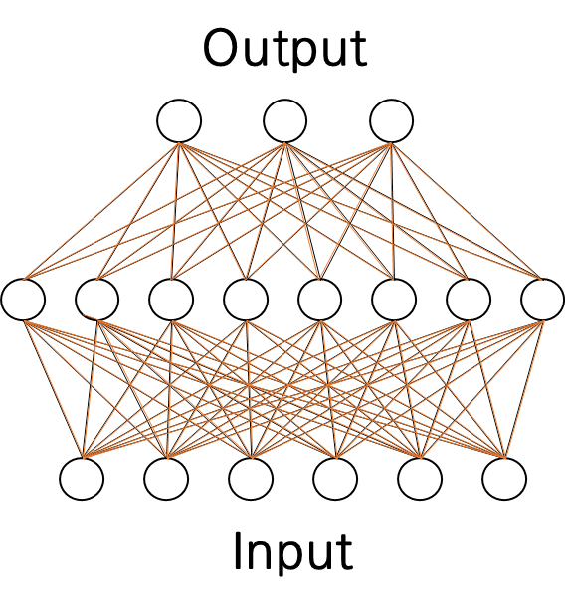
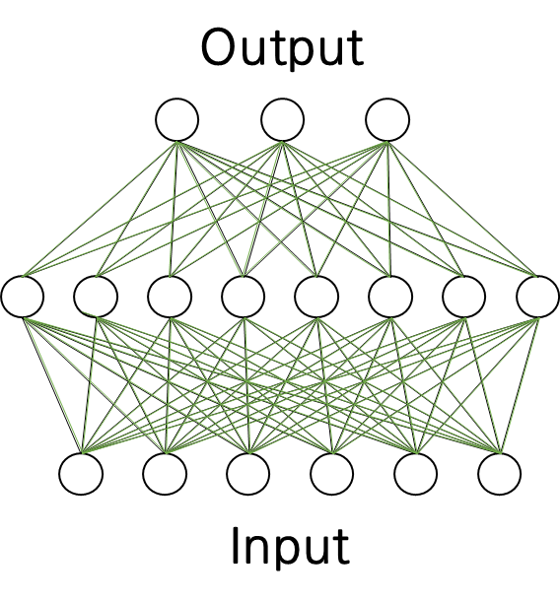
ANN Ensemble
To improve generalization performance
Ensemble could be used
Output
Input

Slide 6
Expensive Ensemble
Because ensemble is composed of many models
Ensemble is computationally expensive
Output
Input

Slide 7
Expensive Ensemble
Test sets are large (e.g. Google)
Storage space at a premium (e.g. Mobile phone)
Output
Input

Slide 8
Expensive Ensemble
Test sets are large (e.g. Google)
Storage space at a premium (e.g. Mobile phone)
i.e. VGGNet network requires 540 MB of storage, which is not suitable for a mobile device*
Output
Input
* Sau, B. B., & Balasubramanian, V. N. (2016). Deep Model Compression: Distilling Knowledge from Noisy Teachers. arXiv preprint arXiv:1610.09650.

Slide 9
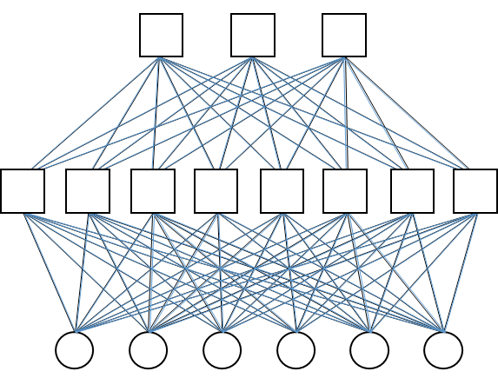
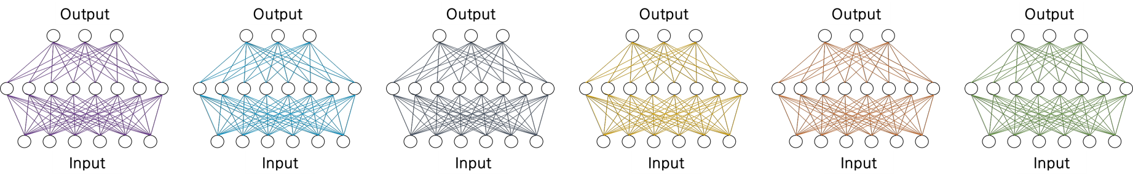
Distilling Ensemble: Single Model
Therefore, we want to get a single (and shallow) model
Good performance
Low computation
Output
Output
Input
Input

Slide 10
Distilling Ensemble: Single Model ①
If we use many observations
Generalization property will be good
Output
Output
Input
Input

Slide 11
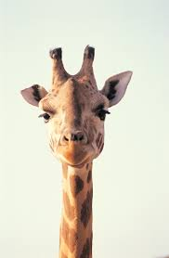
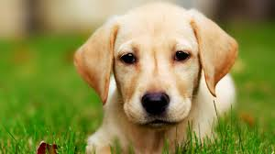
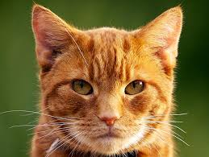
Distilling Ensemble: Single Model ①
If we use many observations
Generalization property will be good
Ensemble
Single Model

Slide 12
Distilling Ensemble: Single Model ①
If we use many observations
Generalization property will be good
Ensemble
Single Model

Slide 13
Distilling Ensemble: Single Model ①
However, we don`t have many observations
weight | color | length | ... | Y
10 | red | 80
30 | yellow | 201
15 | white | 100
6 | gray | 50
5 | gray | 40
* Buciluǎ, C., Caruana, R., & Niculescu-Mizil, A. (2006, August). Model compression. In Proceedings of the 12th ACM SIGKDD international conference on Knowledge discovery and data mining (pp. 535-541). ACM.

Slide 14
Distilling Ensemble: Single Model ①
Alternatively, we can make artificial data
weight | color | length | ... | Y
10 | red | 80
30 | yellow | 201
15 | white | 100
6 | gray | 50
5 | gray | 40
over
sampling
* Buciluǎ, C., Caruana, R., & Niculescu-Mizil, A. (2006, August). Model compression. In Proceedings of the 12th ACM SIGKDD international conference on Knowledge discovery and data mining (pp. 535-541). ACM.

Slide 15
Distilling Ensemble: Single Model ①
Alternatively, we can make artificial data
weight | color | length | ... | Y
10 | red | 80
30 | yellow | 201
15 | white | 100
6 | gray | 50
5 | gray | 40
?
?
?
?
?
?
?
?
20 | gray | 80 |  | ?
32 | yellow | 205 |  | ?
10 | white | 102 |  | ?
8 | gray | 52 |  | ?
9 | white | 42 |  | ?
12 | gray | 45 |  | ?
?
?
?
?
?
?
?
?
?
?
?
over
sampling
?
?
?
?
?
?
?
* Buciluǎ, C., Caruana, R., & Niculescu-Mizil, A. (2006, August). Model compression. In Proceedings of the 12th ACM SIGKDD international conference on Knowledge discovery and data mining (pp. 535-541). ACM.

Slide 16
Distilling Ensemble: Single Model ①
But, we don`t have class label
weight | color | length | ... | Y
10 | red | 80
30 | yellow | 201
15 | white | 100
6 | gray | 50
5 | gray | 40
?
?
?
?
?
?
?
?
20 | gray | 80 |  | ?
32 | yellow | 205 |  | ?
10 | white | 102 |  | ?
8 | gray | 52 |  | ?
9 | white | 42 |  | ?
12 | gray | 45 |  | ?
?
?
?
?
?
?
?
?
?
?
?
over
sampling
?
?
?
?
?
?
?
* Buciluǎ, C., Caruana, R., & Niculescu-Mizil, A. (2006, August). Model compression. In Proceedings of the 12th ACM SIGKDD international conference on Knowledge discovery and data mining (pp. 535-541). ACM.

Slide 17
Distilling Ensemble: Single Model ①
To solve this problem, we build Ensemble model using original data
weight | color | length | ... | Y
10 | red | 80
30 | yellow | 201
15 | white | 100
6 | gray | 50
5 | gray | 40
?
?
?
?
?
?
?
?
20 | gray | 80 |  | ?
32 | yellow | 205 |  | ?
10 | white | 102 |  | ?
8 | gray | 52 |  | ?
9 | white | 42 |  | ?
12 | gray | 45 |  | ?
?
?
?
?
?
?
?
?
?
?
?
?
?
?
?
?
?
?
* Buciluǎ, C., Caruana, R., & Niculescu-Mizil, A. (2006, August). Model compression. In Proceedings of the 12th ACM SIGKDD international conference on Knowledge discovery and data mining (pp. 535-541). ACM.

Slide 18
Distilling Ensemble: Single Model ①
Then, Add class using Prediction of Ensemble model
weight | color | length | ... | Y
10 | red | 80
30 | yellow | 201
15 | white | 100
6 | gray | 50
5 | gray | 40
?
?
?
?
?
?
?
?
20 | gray | 80 |  | ?
32 | yellow | 205 |  | ?
10 | white | 102 |  | ?
8 | gray | 52 |  | ?
9 | white | 42 |  | ?
12 | gray | 45 |  | ?
?
?
?
?
?
?
?
?
?
?
?
?
?
?
?
?
?
?
* Buciluǎ, C., Caruana, R., & Niculescu-Mizil, A. (2006, August). Model compression. In Proceedings of the 12th ACM SIGKDD international conference on Knowledge discovery and data mining (pp. 535-541). ACM.

Slide 19
Distilling Ensemble: Single Model ①
Then, Add class using Prediction of Ensemble model
weight | color | length | ... | Y
10 | red | 80
30 | yellow | 201
15 | white | 100
6 | gray | 50
5 | gray | 40
20 | gray | 80
32 | yellow | 205
10 | white | 102
8 | gray | 52
9 | white | 42
12 | gray | 45
* Buciluǎ, C., Caruana, R., & Niculescu-Mizil, A. (2006, August). Model compression. In Proceedings of the 12th ACM SIGKDD international conference on Knowledge discovery and data mining (pp. 535-541). ACM.

Slide 20
Distilling Ensemble: Single Model ①
Finally, we train single mole using this increased data (Bucilua et al.)*
weight | color | length | ... | Y
10 | red | 80
30 | yellow | 201
15 | white | 100
6 | gray | 50
5 | gray | 40
20 | gray | 80
32 | yellow | 205
10 | white | 102
8 | gray | 52
9 | white | 42
12 | gray | 45
* Buciluǎ, C., Caruana, R., & Niculescu-Mizil, A. (2006, August). Model compression. In Proceedings of the 12th ACM SIGKDD international conference on Knowledge discovery and data mining (pp. 535-541). ACM.

Slide 21
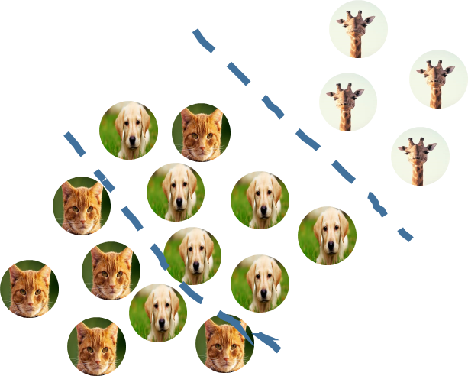
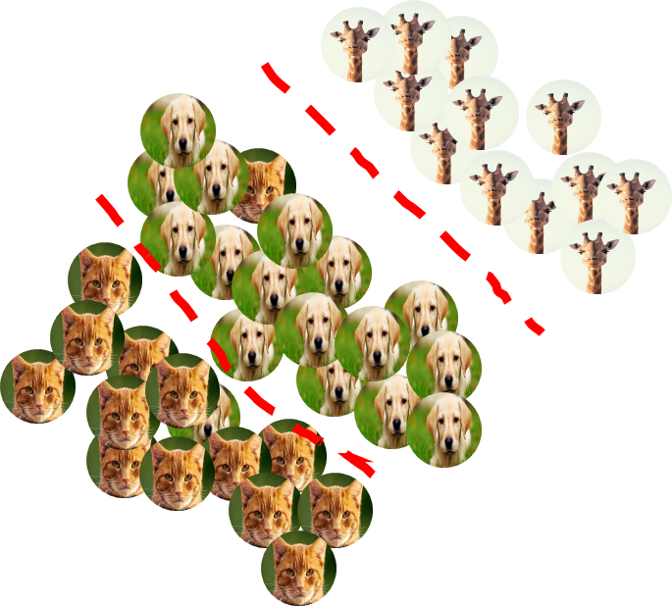
Distilling Ensemble: Single Model ①
If we use many observations
Generalization property will be good
Output
Output
Input
Input

Slide 22
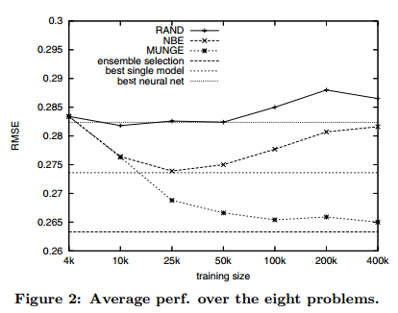
Distilling Ensemble: Single Model ①
More training data, Less Error
Model Compression
Best Ensemble
* Buciluǎ, C., Caruana, R., & Niculescu-Mizil, A. (2006, August). Model compression. In Proceedings of the 12th ACM SIGKDD international conference on Knowledge discovery and data mining (pp. 535-541). ACM.

Slide 23
Distilling Ensemble: Single Model ②
We can use predicted 'class' of Ensemble
But, we can select another approach
* Hinton, G., Vinyals, O., & Dean, J. (2015). Distilling the knowledge in a neural network. arXiv preprint arXiv:1503.02531.

Slide 24
Distilling Ensemble: Single Model ②
If we use the probability of class
Generalization property will be good
* Hinton, G., Vinyals, O., & Dean, J. (2015). Distilling the knowledge in a neural network. arXiv preprint arXiv:1503.02531.

Slide 25
Distilling Ensemble: Single Model ②-1
We can use 'logit' instead of class (Ba et al.)*
weight | color | length | ... | Y
10 | red | 80 |  | 2
30 | yellow | 201 |  | 1
15 | white | 100 |  | 3
6 | gray | 50 |  | 3
5 | gray | 40 |  | 2
2
3
3
2
3
2
3
2
3
2
2
3
-4
3
20 | gray | 80 |  | -2
32 | yellow | 205 |  | 3
10 | white | 102 |  | 1
8 | gray | 52 |  | 3
9 | white | 42 |  | -2
12 | gray | 45 |  | 1
3
2
2
2
1
2
2
3
2
3
1
1
3
2
2
3
2
2
-2
3
2
2
1
1
2
1
2
* Ba, J., & Caruana, R. (2014). Do deep nets really need to be deep?. In Advances in neural information processing systems (pp. 2654-2662).

Slide 26
Distilling Ensemble: Single Model ②-1
Logit could be understood as score of class
weight | color | length | ... | Y
10 | red | 80 |  | 2
30 | yellow | 201 |  | 1
15 | white | 100 |  | 3
6 | gray | 50 |  | 3
5 | gray | 40 |  | 2
2
3
3
2
3
2
3
2
3
2
2
3
-4
3
20 | gray | 80 |  | -2
32 | yellow | 205 |  | 3
10 | white | 102 |  | 1
8 | gray | 52 |  | 3
9 | white | 42 |  | -2
12 | gray | 45 |  | 1
3
2
2
2
1
2
2
3
2
3
1
1
3
2
2
3
2
2
-2
3
2
2
1
1
2
1
2
* Ba, J., & Caruana, R. (2014). Do deep nets really need to be deep?. In Advances in neural information processing systems (pp. 2654-2662).

Slide 27
Input

Slide 28
10
21
5
6
3
20
Input

Slide 29
0.5
0.7
0.3
1.2
1.1
0.1
10
21
5
6
3
20
Input

Slide 30
W*X
33.7
33.7 =
0.5*10 + 0.7*21 + 0.3*5 +
1.2*6 + 1.1*3 + 0.1*20
0.5
0.7
0.3
1.2
1.1
0.1
10
21
5
6
3
20
Input

Slide 31
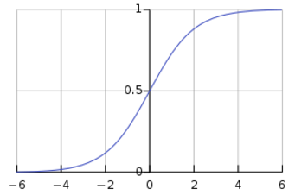
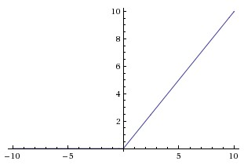
H1 = activation(W*X)
33.7
33.7 =
0.5*10 + 0.7*21 + 0.3*5 +
1.2*6 + 1.1*3 + 0.1*20
0.5
0.7
0.3
1.2
1.1
0.1
10
21
5
6
3
20
Input

Slide 32
H1 = activation(W*X)
0.99
33.7 =
0.5*10 + 0.7*21 + 0.3*5 +
1.2*6 + 1.1*3 + 0.1*20
0.5
0.7
0.3
1.2
1.1
0.1
10
21
5
6
3
20
Input

Slide 33
H1 = activation(W*X)
33.7
33.7 =
0.5*10 + 0.7*21 + 0.3*5 +
1.2*6 + 1.1*3 + 0.1*20
0.5
0.7
0.3
1.2
1.1
0.1
10
21
5
6
3
20
Input

Slide 34
W*H
...
0.2
1.2
0.1
0.7
33.7
21
5
16
43
0.2
0.9
1.1
Input

Slide 35
Logit = W*H
1.39
...
0.2
1.2
0.1
0.7
33.7
21
5
16
43
0.2
0.9
1.1
Input

Slide 36
0.8
O = activation( )
1.39
Logit = W*H
...
0.2
1.2
0.1
0.7
33.7
21
5
16
43
0.2
0.9
1.1
Input

Slide 37
0.8
0.5
0.1
O = activation( )
1.39
Logit = W*H
...
0.2
1.2
0.1
0.7
33.7
21
5
16
43
0.2
0.9
1.1
Input

Slide 38
0.8
0.5
0.1
O = activation( )
1.39
Logit = W*H
...
0.2
1.2
0.1
0.7
33.7
21
5
16
43
0.2
0.9
1.1
Input

Slide 39
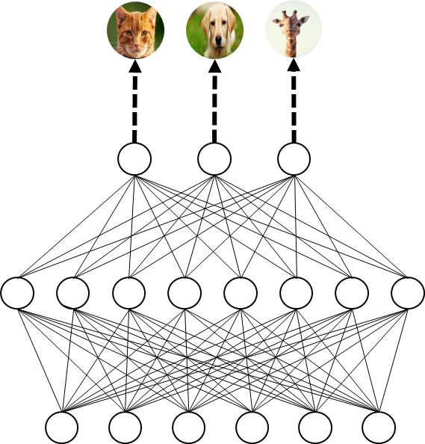
Distilling Ensemble: Single Model ②-1
weight | color | length | ... | Y
10 | red | 80
10
red
80
...
* Ba, J., & Caruana, R. (2014). Do deep nets really need to be deep?. In Advances in neural information processing systems (pp. 2654-2662).

Slide 40
Distilling Ensemble: Single Model ②-1
weight | color | length | ... | Y
10 | red | 80
2
2
10
red
80
...
* Ba, J., & Caruana, R. (2014). Do deep nets really need to be deep?. In Advances in neural information processing systems (pp. 2654-2662).

Slide 41
Distilling Ensemble: Single Model ②-1
We can use 'logit' instead of class (Ba et al.)*
weight | color | length | ... | Y
10 | red | 80 |  | 2
30 | yellow | 201 |  | 1
15 | white | 100 |  | 3
6 | gray | 50 |  | 3
5 | gray | 40 |  | 2
2
3
3
2
3
2
3
2
3
2
2
3
-4
3
20 | gray | 80 |  | -2
32 | yellow | 205 |  | 3
10 | white | 102 |  | 1
8 | gray | 52 |  | 3
9 | white | 42 |  | -2
12 | gray | 45 |  | 1
3
2
2
2
1
2
2
3
2
3
1
1
3
2
2
3
2
2
-2
3
2
2
1
1
2
1
2
* Ba, J., & Caruana, R. (2014). Do deep nets really need to be deep?. In Advances in neural information processing systems (pp. 2654-2662).

Slide 42
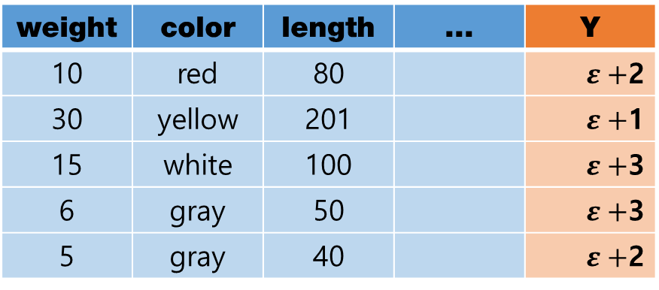

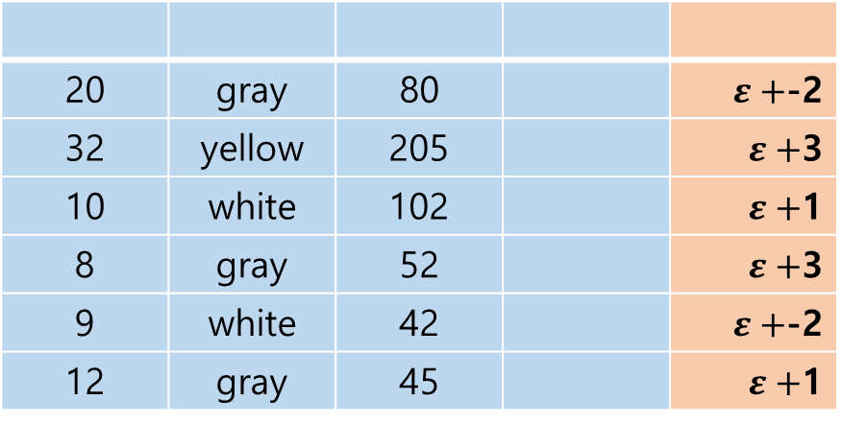
Distilling Ensemble: Single Model ②-2
We can add 'noise' to 'logit', which acts as regularizer (Sau et al.)*
weight | color | length | ... | Y
10 | red | 80 |  | $ε+$2
30 | yellow | 201 |  | $ε+$1
15 | white | 100 |  | $ε+$3
6 | gray | 50 |  | $ε+$3
5 | gray | 40 |  | $ε+$2
2
3
3
2
3
2
3
2
3
2
2
3
-4
3
20 | gray | 80 |  | $ε+$-2
32 | yellow | 205 |  | $ε+$3
10 | white | 102 |  | $ε+$1
8 | gray | 52 |  | $ε+$3
9 | white | 42 |  | $ε+$-2
12 | gray | 45 |  | $ε+$1
3
2
2
2
1
2
2
3
2
3
1
1
3
2
2
3
2
-2
2
3
$+$ $ε$
2
2
1
2
2
2
2
* Sau, B. B., & Balasubramanian, V. N. (2016). Deep Model Compression: Distilling Knowledge from Noisy Teachers. arXiv preprint arXiv:1610.09650.

Slide 43
Distilling Ensemble: Single Model ②-2
We can add 'noise' to 'logit', which acts as regularizer (Sau et al.)*
weight | color | length | ... | Y
10 | red | 80 |  | $ε+$2
30 | yellow | 201 |  | $ε+$1
15 | white | 100 |  | $ε+$3
6 | gray | 50 |  | $ε+$3
5 | gray | 40 |  | $ε+$2
2
3
3
2
3
2
3
2
3
2
2
3
-4
3
20 | gray | 80 |  | $ε+$-2
32 | yellow | 205 |  | $ε+$3
10 | white | 102 |  | $ε+$1
8 | gray | 52 |  | $ε+$3
9 | white | 42 |  | $ε+$-2
12 | gray | 45 |  | $ε+$1
3
2
2
2
1
2
2
3
2
3
1
1
3
2
2
3
2
-2
2
3
$+$ $ε$
2
2
1
2
2
2
2
* Sau, B. B., & Balasubramanian, V. N. (2016). Deep Model Compression: Distilling Knowledge from Noisy Teachers. arXiv preprint arXiv:1610.09650.

Slide 44
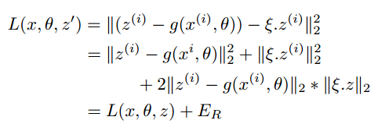
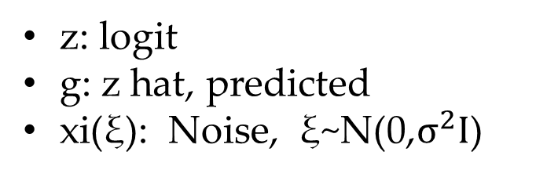
Distilling Ensemble: Single Model ②-2
We can add 'noise' to 'logit', which acts as regularizer (Sau et al.)*
weight | color | length | ... | Y
10 | red | 80 |  | $ε+$2
30 | yellow | 201 |  | $ε+$1
15 | white | 100 |  | $ε+$3
6 | gray | 50 |  | $ε+$3
5 | gray | 40 |  | $ε+$2
2
3
3
2
3
2
3
Noisy data in training helps to regularize a model (Sau et al.)*
-4
2
3
2
2
3
3
20 | gray | 80 |  | $ε+$-2
32 | yellow | 205 |  | $ε+$3
10 | white | 102 |  | $ε+$1
8 | gray | 52 |  | $ε+$3
9 | white | 42 |  | $ε+$-2
12 | gray | 45 |  | $ε+$1
3
2
2
2
1
2
2
3
3
z: logit
g: z hat, predicted
xi(ξ): Noise, ξ~N(0,$σ^{2}I$)
2
1
3
1
2
3
2
-2
2
2
3
$+$ $ε$
2
2
1
2
2
2
2
* Sau, B. B., & Balasubramanian, V. N. (2016). Deep Model Compression: Distilling Knowledge from Noisy Teachers. arXiv preprint arXiv:1610.09650.

Slide 45
Distilling Ensemble: Single Model ②-3
Hinton* used softmax function to get prob. distribution
weight | color | length | ... | Y
10 | red | 80
30 | yellow | 201
15 | white | 100
6 | gray | 50
5 | gray | 40
Train Ensemble model
* Hinton, G., Vinyals, O., & Dean, J. (2015). Distilling the knowledge in a neural network. arXiv preprint arXiv:1503.02531.

Slide 46
Distilling Ensemble: Single Model ②-3
Hinton* used softmax function to get prob. distribution
weight | color | length | ... | Y
10 | red | 80
30 | yellow | 201
15 | white | 100
6 | gray | 50
5 | gray | 40
Train Ensemble model
Calculate prob. with Softmax function
* Hinton, G., Vinyals, O., & Dean, J. (2015). Distilling the knowledge in a neural network. arXiv preprint arXiv:1503.02531.

Slide 47
Distilling Ensemble: Single Model ②-3
Hinton used softmax function to get prob. distribution
weight | color | length | ... | Y
10 | red | 80
30 | yellow | 201
15 | white | 100
6 | gray | 50
5 | gray | 40
Train Ensemble model
Calculate prob. with Softmax function
0.9
* Hinton, G., Vinyals, O., & Dean, J. (2015). Distilling the knowledge in a neural network. arXiv preprint arXiv:1503.02531.

Slide 48
Distilling Ensemble: Single Model ②-3
Hinton used softmax function to get prob. distribution
weight | color | length | ... | Y
10 | red | 80
30 | yellow | 201
15 | white | 100
6 | gray | 50
5 | gray | 40
Train Ensemble model
Calculate prob. with Softmax function
* Hinton, G., Vinyals, O., & Dean, J. (2015). Distilling the knowledge in a neural network. arXiv preprint arXiv:1503.02531.

Slide 49
Distilling Ensemble: Single Model ②-3
Hinton used softmax function to get prob. distribution
weight | color | length | ... | Y
10 | red | 80
30 | yellow | 201
15 | white | 100
6 | gray | 50
5 | gray | 40
Train Ensemble model
Calculate prob. with Softmax function
* Hinton, G., Vinyals, O., & Dean, J. (2015). Distilling the knowledge in a neural network. arXiv preprint arXiv:1503.02531.

Slide 50
Distilling Ensemble: Single Model ②-3
Then, we obtain prob. and use prob. as Y
weight | color | length | ... | Prob.
10 | red | 80 |  | 0.90
30 | yellow | 201 |  | 0.95
15 | white | 100 |  | 0.10
6 | gray | 50 |  | 0.70
5 | gray | 40 |  | 0.75
* Hinton, G., Vinyals, O., & Dean, J. (2015). Distilling the knowledge in a neural network. arXiv preprint arXiv:1503.02531.

Slide 51
Distilling Ensemble: Single Model ②-3
Then, we obtain prob. and use prob. as Y
weight | color | length | ... | Prob.
10 | red | 80 |  | 0.90
30 | yellow | 201 |  | 0.95
15 | white | 100 |  | 0.10
6 | gray | 50 |  | 0.70
5 | gray | 40 |  | 0.75
Train single model
Prob. acts like regularization
* Hinton, G., Vinyals, O., & Dean, J. (2015). Distilling the knowledge in a neural network. arXiv preprint arXiv:1503.02531.

Slide 52
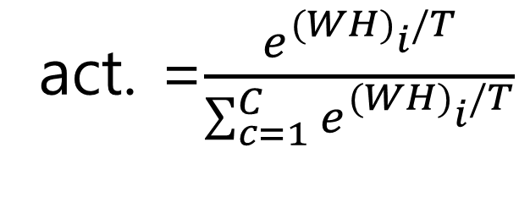
Softmax is an one of activation function
0.9
0.08
0.02
act. =$\frac{e^{{(WH)}_{i}^{ }/T}}{\sum_{c=1}^{C}{e^{{(WH)}_{i}^{ }/T}}}$
O = activation( )
1.39
Logit = W*H
...
0.2
1.2
0.1
0.7
33.7
21
5
16
43
0.2
0.9
1.1
Input

Slide 53
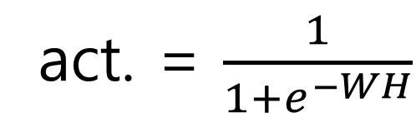
Another activation function is a sigmoid function
0.8
0.5
0.1
act. = $\frac{1}{1+e^{−WH}}$
O = activation( )
1.39
Logit = W*H
...
0.2
1.2
0.1
0.7
33.7
21
5
16
43
0.2
0.9
1.1
Input

Slide 54
The sum of Sigmoid value is not 1
But, sum of probability distribution have to be 1
0.8
0.5
0.1
act. = $\frac{1}{1+e^{−WH}}$
O = activation( )
1.39
Logit = W*H
...
0.2
1.2
0.1
0.7
33.7
21
5
16
43
0.2
0.9
1.1
Input

Slide 55
To make sum 1, we use softmax function
0.9
0.08
0.02
0.8
0.5
0.1
act. =$\frac{e^{{(WH)}_{i}^{ }/T}}{\sum_{c=1}^{C}{e^{{(WH)}_{i}^{ }/T}}}$
O = activation( )
1.39
Logit = W*H
...
0.2
1.2
0.1
0.7
33.7
21
5
16
43
0.2
0.9
1.1
Input

Slide 56
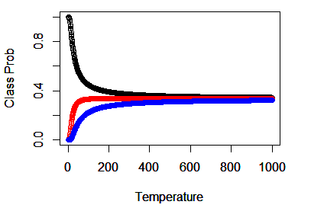
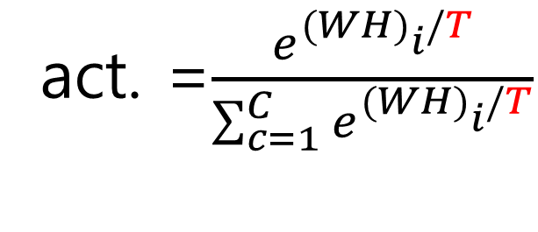
To make sum 1, we use softmax function
Temperature
0.9
0.08
0.02
0.8
0.5
0.1
act. =$\frac{e^{{(WH)}_{i}^{ }/T}}{\sum_{c=1}^{C}{e^{{(WH)}_{i}^{ }/T}}}$
0
...
10
O = activation( )
1.39
Logit = W*H
...
0.2
1.2
0.1
0.7
33.7
21
5
16
43
0.2
0.9
1.1
Input
* Hinton, G., Vinyals, O., & Dean, J. (2015). Distilling the knowledge in a neural network. arXiv preprint arXiv:1503.02531.

Slide 57
To make sum 1, we use softmax function
Temperature
0.9
0.08
0.02
0.8
0.5
0.1
act. =$\frac{e^{{(WH)}_{i}^{ }/T}}{\sum_{c=1}^{C}{e^{{(WH)}_{i}^{ }/T}}}$
0
...
10
O = activation( )
1.39
Logit = W*H
There is no difference between samples
* Hinton, G., Vinyals, O., & Dean, J. (2015). Distilling the knowledge in a neural network. arXiv preprint arXiv:1503.02531.

Slide 58
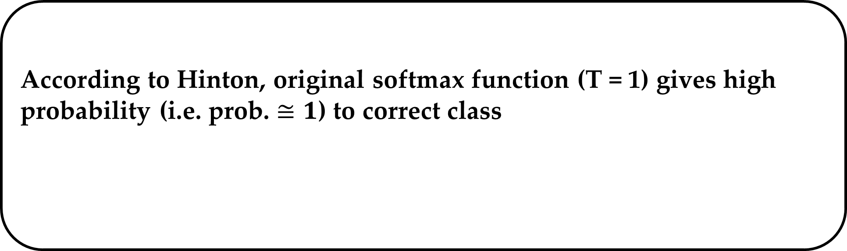
According to Hinton, original softmax function (T = 1) gives high probability (i.e. prob. $≅1$) to correct class
To make sum 1, we use softmax function
Temperature
0.9
0.08
0.02
0.8
0.5
0.1
act. =$\frac{e^{{(WH)}_{i}^{ }/T}}{\sum_{c=1}^{C}{e^{{(WH)}_{i}^{ }/T}}}$
Therefore, we need to set temperature more higher than T = 1 {i.e. 2~5}
0
...
10
O = activation( )
1.39
Logit = W*H
There is no difference between samples
* Hinton, G., Vinyals, O., & Dean, J. (2015). Distilling the knowledge in a neural network. arXiv preprint arXiv:1503.02531.

Slide 59
To make sum 1, we use softmax function
Temperature
0.9
0.08
0.02
0.8
0.5
0.1
act. =$\frac{e^{{(WH)}_{i}^{ }/T}}{\sum_{c=1}^{C}{e^{{(WH)}_{i}^{ }/T}}}$
0
...
10
O = activation( )
1.39
Logit = W*H
All obs. have same probability
* Hinton, G., Vinyals, O., & Dean, J. (2015). Distilling the knowledge in a neural network. arXiv preprint arXiv:1503.02531.

Slide 60
To make sum 1, we use softmax function
Temperature
0.9
0.08
0.02
0.8
0.5
0.1
act. =$\frac{e^{{(WH)}_{i}^{ }/T}}{\sum_{c=1}^{C}{e^{{(WH)}_{i}^{ }/T}}}$
0
...
10
O = activation( )
1.39
Logit = W*H
Appropriate Temperature
Different prob.
* Hinton, G., Vinyals, O., & Dean, J. (2015). Distilling the knowledge in a neural network. arXiv preprint arXiv:1503.02531.

Slide 61
To make sum 1, we use softmax function
Temperature
0.9
0.08
0.02
0.8
0.5
0.1
act. =$\frac{e^{{(WH)}_{i}^{ }/T}}{\sum_{c=1}^{C}{e^{{(WH)}_{i}^{ }/T}}}$
0
...
10
O = activation( )
1.39
Logit = W*H
Appropriate Temperature
Different prob.
Small prob.
* Hinton, G., Vinyals, O., & Dean, J. (2015). Distilling the knowledge in a neural network. arXiv preprint arXiv:1503.02531.

Slide 62
Distilling Ensemble ②-3
weight | color | length | ... | Prob.
10 | red | 80 |  | 0.90
30 | yellow | 201 |  | 0.95
15 | white | 100 |  | 0.10
6 | gray | 50 |  | 0.70
5 | gray | 40 |  | 0.75
0
...
10
Train single model
* Hinton, G., Vinyals, O., & Dean, J. (2015). Distilling the knowledge in a neural network. arXiv preprint arXiv:1503.02531.

Slide 63
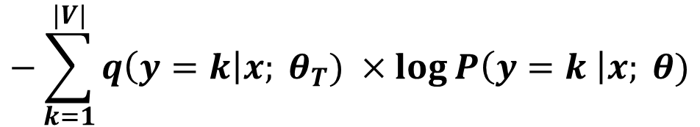
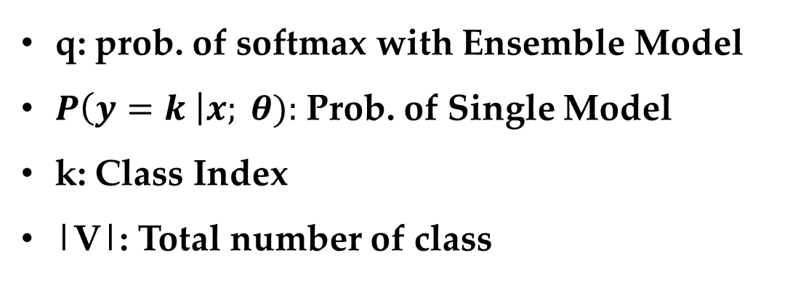
Distilling Ensemble: Single Model ②-3
Cost function is a variant of cross entropy
$$−\sum_{k=1}^{|V|}{q\left(y=k\right|x; θ_{T}) ×\log{P\left(y=k \right|x; θ)}}$$
Cost Function:
q: prob. of softmax with Ensemble Model
$P\left(y=k \right|x; θ):$ Prob. of Single Model
k: Class Index
|V|: Total number of class
* Hinton, G., Vinyals, O., & Dean, J. (2015). Distilling the knowledge in a neural network. arXiv preprint arXiv:1503.02531.

Slide 64
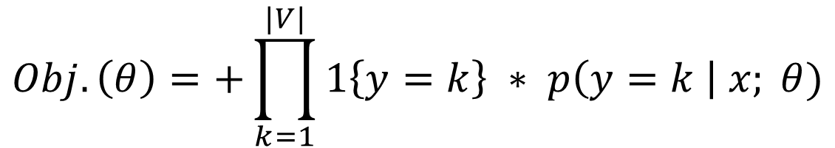
Cross Entropy
We want to maximize objective function
$$Obj. \left(θ\right)=+\prod_{k=1}^{|V|}{1\left\{y=k\right\} ∗ p\left(y=k \right| x; θ)}$$
Indicator of True Class
Predicted Prob. of True Class
(Our Model)

Slide 65
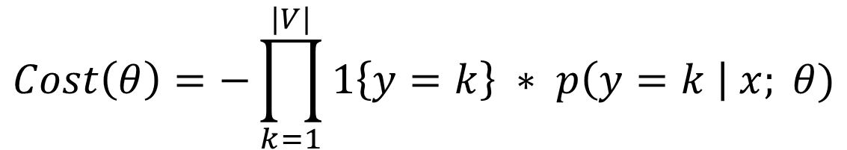
Cross Entropy
Convert objective function to cost function
$$Obj. \left(θ\right)=+\prod_{k=1}^{|V|}{1\left\{y=k\right\} ∗ p\left(y=k \right| x; θ)}$$
$$Cost\left(θ\right)=−\prod_{k=1}^{|V|}{1\left\{y=k\right\} ∗ p\left(y=k \right| x; θ)}$$

Slide 66
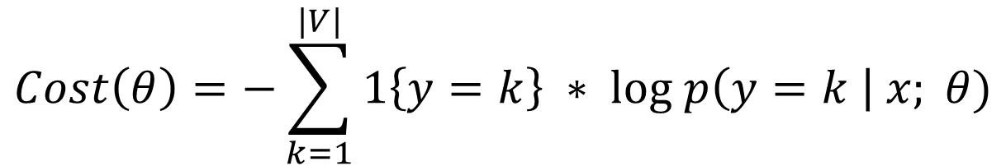
Cross Entropy
Log transform of cost function, which prevent probability goes to 0
$$Obj. \left(θ\right)=+\prod_{k=1}^{|V|}{1\left\{y=k\right\} ∗ p\left(y=k \right| x; θ)}$$
$$Cost\left(θ\right)=−\prod_{k=1}^{|V|}{1\left\{y=k\right\} ∗ p\left(y=k \right| x; θ)}$$
$$Cost\left(θ\right)=−\sum_{k=1}^{|V|}{1\left\{y=k\right\} ∗ log p\left(y=k \right| x; θ)}$$

Slide 67
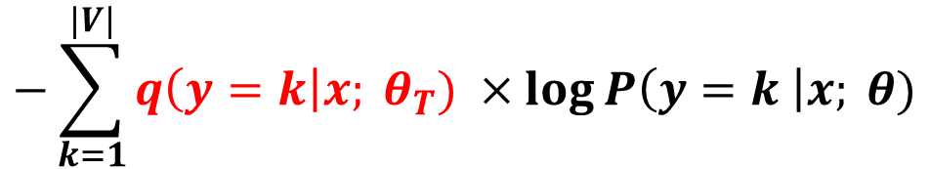
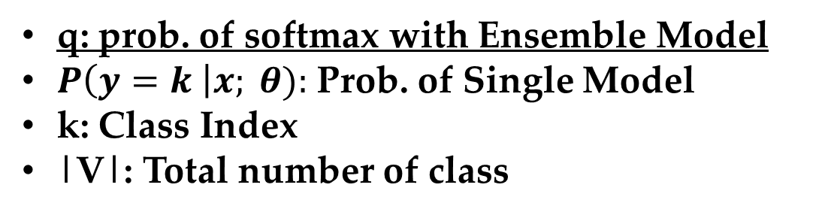
Distilling Ensemble: Single Model ②-3
Cost function is a variant of cross entropy
$$−\sum_{k=1}^{|V|}{q\left(y=k\right|x; θ_{T}) ×\log{P\left(y=k \right|x; θ)}}$$
Cost Function:
q: prob. of softmax with Ensemble Model
$P\left(y=k \right|x; θ):$ Prob. of Single Model
k: Class Index
|V|: Total number of class
We use prob. of ensemble rather than indicator function
$$Cost\left(θ\right)=−\sum_{k=1}^{|V|}{1\left\{y=k\right\} ∗ log p\left(y=k \right| x; θ)}$$
* Hinton, G., Vinyals, O., & Dean, J. (2015). Distilling the knowledge in a neural network. arXiv preprint arXiv:1503.02531.

Slide 68
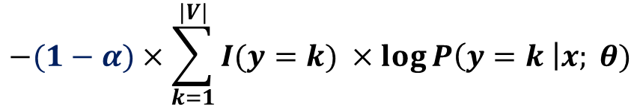
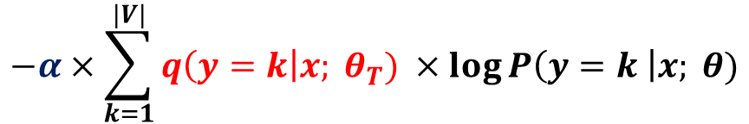
Distilling Ensemble: Single Model ②-3
Cost function is a variant of cross entropy
$$−\sum_{k=1}^{|V|}{q\left(y=k\right|x; θ_{T}) ×\log{P\left(y=k \right|x; θ)}}$$
Cost Function:
Output
Hinton et al. found that using the original set together works well (maybe due to the original target information)
Probabilty of
the label
$$−α×\sum_{k=1}^{|V|}{q\left(y=k\right|x; θ_{T}) ×\log{P\left(y=k \right|x; θ)}}$$
Target is a class probability of Ensemble
Input
$$−(1−α)×\sum_{k=1}^{|V|}{I(y=k) ×\log{P\left(y=k \right|x; θ)}}$$
Target is a class of original data

Slide 69
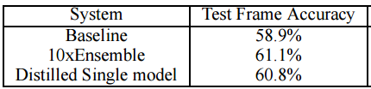
Result 1: MNIST image data
Two hidden layer + ReLU: 146 test errors
Two hidden layer + ReLU + DropOut: 67 test errors
Two hidden layer + ReLU + Soft Target: 74 test errors
Results 2: speech recognition
* Hinton, G., Vinyals, O., & Dean, J. (2015). Distilling the knowledge in a neural network. arXiv preprint arXiv:1503.02531.

Slide 70
Conclusion
Single model can be built using artificial data or soft target* (prob.)
Good performance
Low computation
* Hinton, G., Vinyals, O., & Dean, J. (2015). Distilling the knowledge in a neural network. arXiv preprint arXiv:1503.02531.

Slide 71
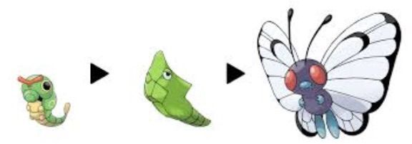
Conclusion
Hinton describe this process as metamorphosis
Train Data
Ensemble
Single Model
* Hinton, G., Vinyals, O., & Dean, J. (2015). Distilling the knowledge in a neural network. arXiv preprint arXiv:1503.02531.

